Slide 1
University of Piraeus
Microservice
Messaging
Apostolou Athanasios (mpsp 2203)
Birmpakos Georgios (mpsp 2220)
Evangelou Ioannis Alexandros (mpsp 2210)

Slide 2
Building the Messaging Microservices
01
Running RabbitMQ
Install Docker Desktop
Running RabbitMQ
02
Configuring the new Project
Creating the Class Library Project for .NET
Creating the MessageContracts class
03
Building the Microservices
Invoice Microservice
Payment Microservice
Test Client
04
Testing
Testing that messages are being sent from the Client to Invoice Microservice.
Testing that Invoice Microservice sends messages to Payment Microservice and to Test Client.

Slide 3
Running RabbitMQ

Slide 4


Running RabbitMQ
1 . Install Docker Image "Rabbit MQ 10.5"
1
2. Run Rabbit MQ by Command Prompt
Docker Desktop
1 .Install Docker Desktop
2. Install WSL2
2
3. Run Docker Desktop
RabbitMQ

Slide 5
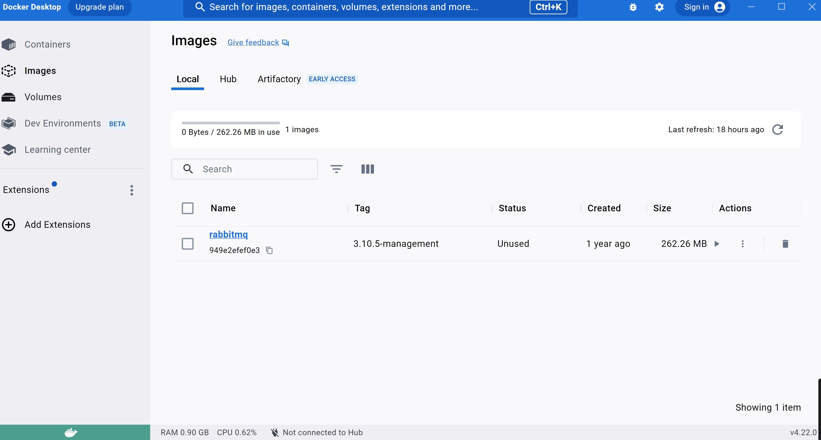

Slide 6
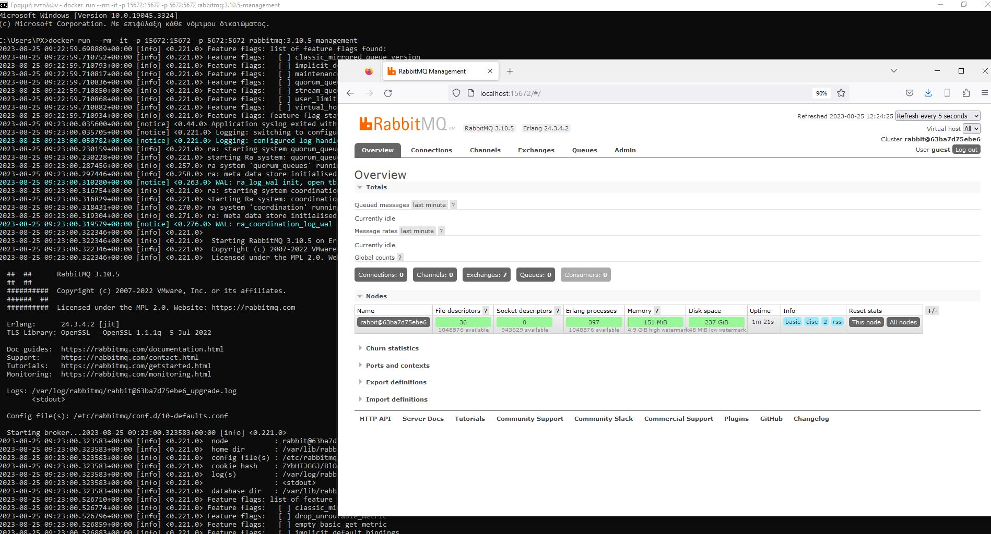

Slide 7
Configuring New Project

Slide 8
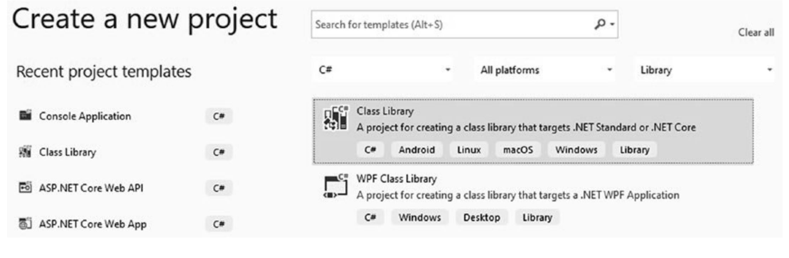
Configuring New Project
1
Creating the Class Library Project for .NET
2
The MessageContracts class defines the format and structure of messages that will be exchanged between different microservices of the messaging system.
Creating the MessageContracts class

Slide 9
Building the Microservices

Slide 10
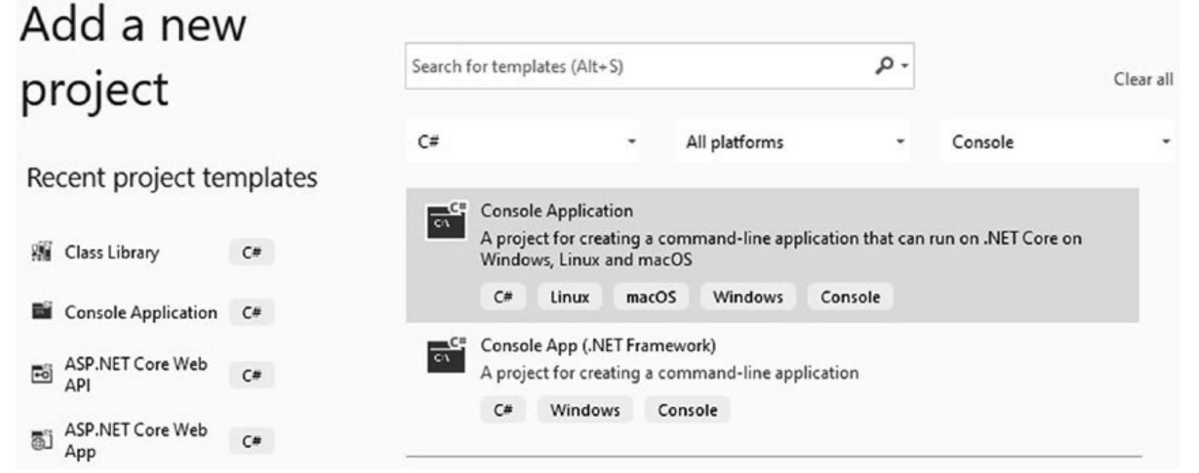
Invoice Microservice
1
Adding a new Console App Project
Installing MassTransit Library with RabbitMQ (Package Manager)
Connecting this project to MessageContract project (Dependency)
2
Implementing the Invoice Microservice code
This code sets up a microservice that listens for messages of type IInvoiceToCreate from the "invoice-service" queue. When a message is received, it processes the message's data, generates an invoice number, prints the information to the console, and publishes an IInvoiceCreated message indicating the successful creation of the invoice.

Slide 11
Payment Microservice
1
Adding a new Console App Project
Installing MassTransit Library with RabbitMQ (Package Manager)
Connecting this project to MessageContract project (Dependency)
2
Implementing the Payment Microservice code
This code sets up a microservice that listens for messages of type IInvoiceCreated from the "payment-service" queue. When such a message is received, it prints a message to the console indicating that the message for a specific invoice number has been received.

Slide 12
Test Client
1
Adding a new Console App Project
Installing MassTransit Library with RabbitMQ (Package Manager)
Connecting this project to MessageContract project (Dependency)
2
Implementing the Test Client code
This code simulates a user interacting with the system by sending simulated invoice creation requests to the microservices and observing the responses. It helps test the interaction between different parts of the system and demonstrates the message-based communication between microservices.

Slide 13
Testing

Slide 14
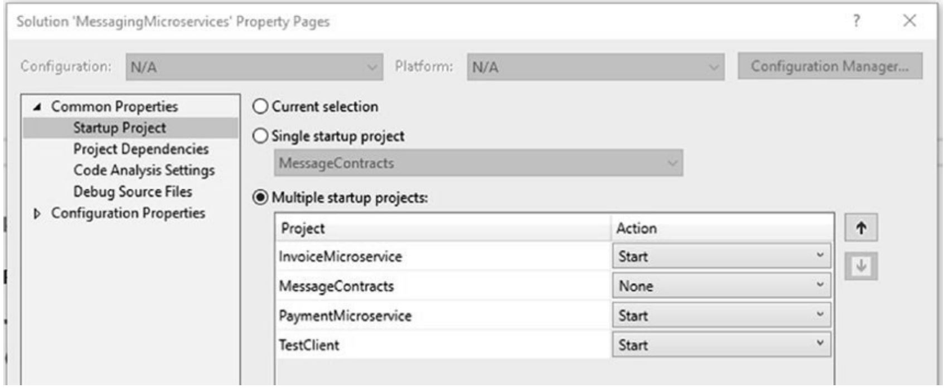
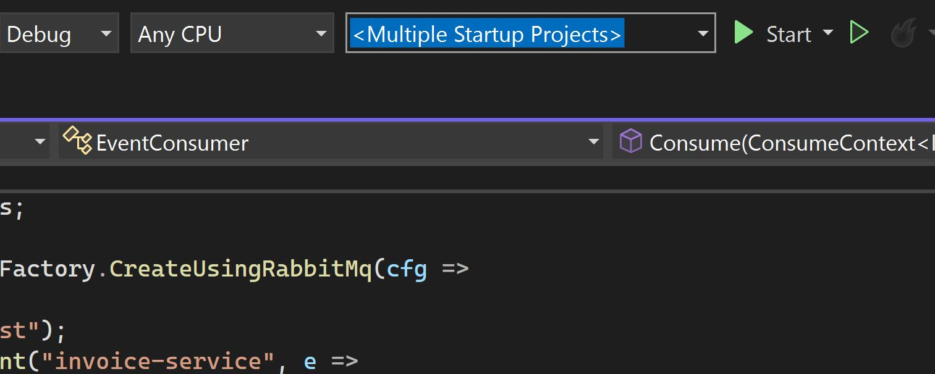

Testing / Before Running the App
1
Setting Multiple Startup Projects
2
Starting the Application
!! Before start running the app, don’t forger to have started running RabbitMQ on localhost:15672 !!

Slide 15
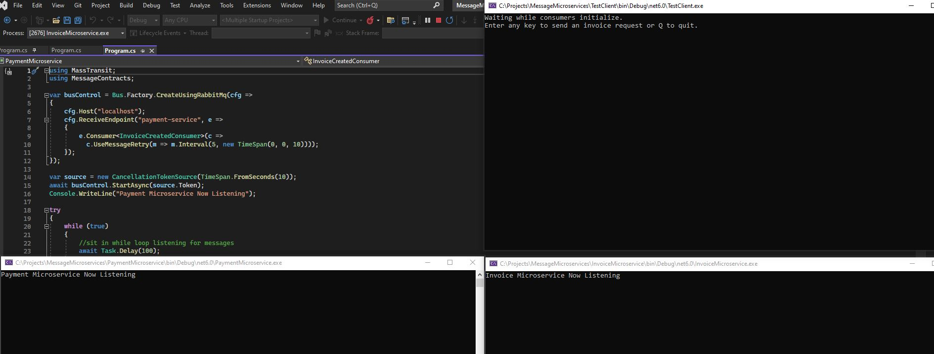




Testing / Running & Testing the App
After Starting the Multiple Projects we will see the following three windows : 1. Test Client, 2. Invoice Microservice, 3. Payment Microservice.
Entering any key , except Q - which terminates the process - , Invoice Microservice will process the invoice and will send a message to the Test Client and to the Payment Microservice.

Slide 16
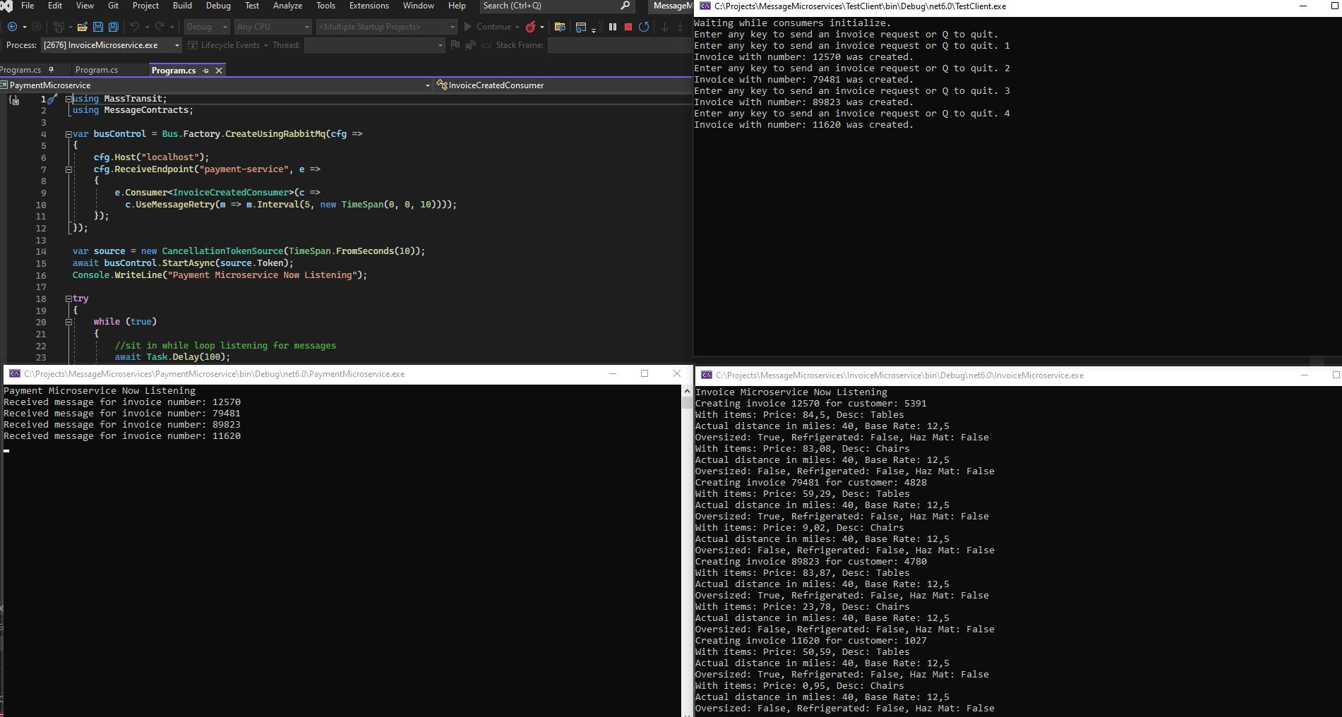



Testing / Running & Testing the App
Sending Invoice Request….
Creating the Invoice ….
Sending an Invoice Creation Message…

Slide 17
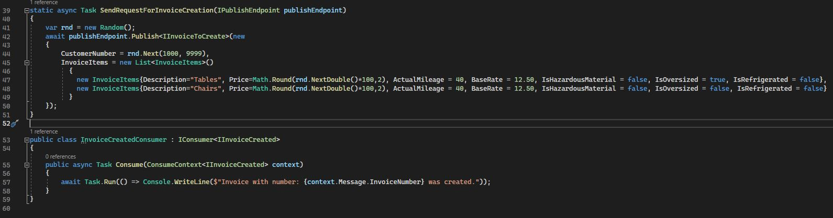
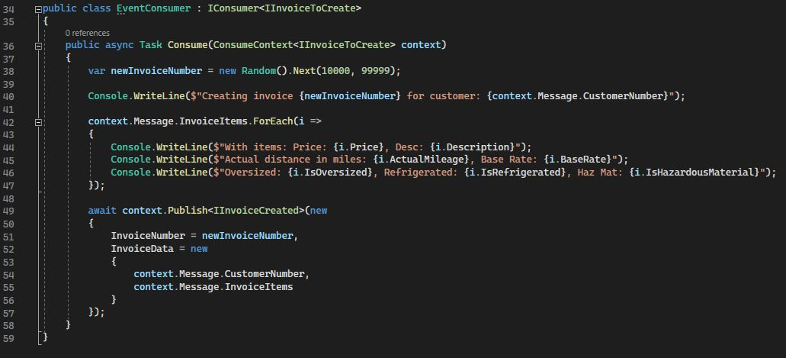
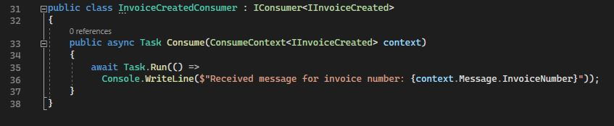
Testing / The code
1
The Test Client publishes messages to the Invoice Microservice and waits for response from the Invoice Microservice
2
The Invoice Microservice waits for messages from the Test Client and sends message to Test Client and to Payment Microservice
3
The Payment Microservice waits for messages from the Invoice Microservice

Slide 18
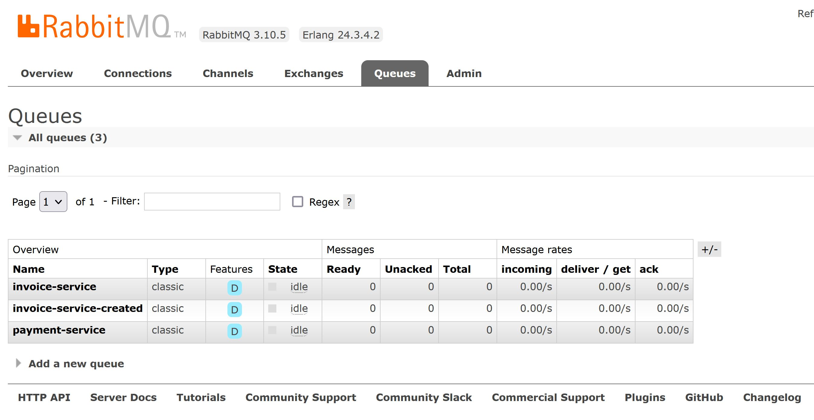

Testing / RabbitMQ - Queues Created

